Slide 1
Contents:
Introduction
Problem statement
Solution
Objectives
Literature survey
Application of inventory management

Slide 2
Introduction:
Inventory is a physical resource that a firm holds in stock with the intent of selling it or transforming it into a more valuable state.
Inventory management is a step in the supply chain where inventory and stock quantities are tracked in and out of your warehouse.
An inventory management system is a tool that allows you to track goods across your business's supply chain. It optimizes the entire spectrum spanning from order placement with your vendor to order delivery to your customer, mapping the complete journey of a product.
Smart Inventory Management System is an online software application which fulfills the requirement of a typical Stock Analysis in various go downs.

Slide 3
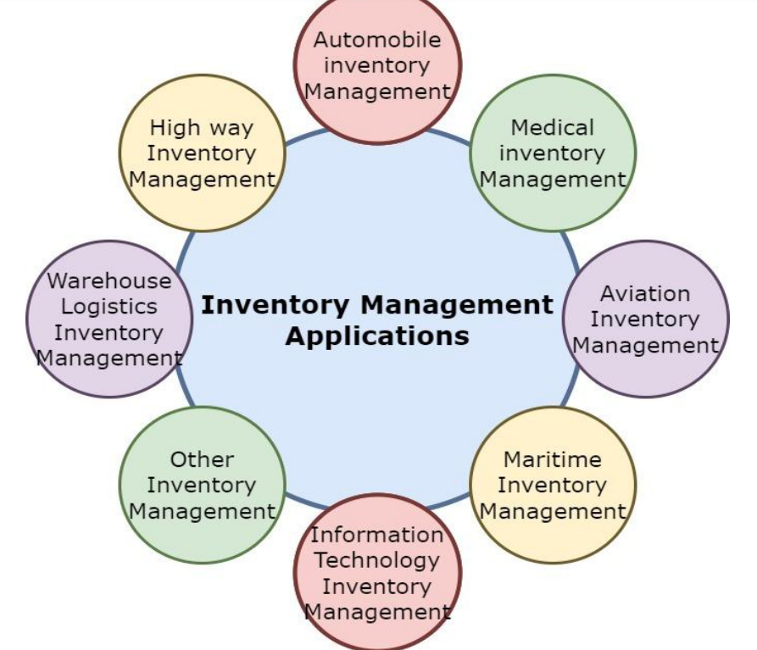
Applications of Inventory Management

Slide 4
Problem statement:
Inventory management is one of the basic problems for a company .it may cause a lot of paperwork , if there is no automated system available.
The process of manually looking for the inventory available in stock is really time consuming and cumbersome that includes the person responsible to see how many materials are in the inventory , how many materials have been ordered and received and keep the record of the time that will take for the suppliers to process orders and other various tasks included in inventory .

Slide 5
Solutions
Inventory management software
Standardize inventory processes
Regular inventory audits:
Mobile Inventory Management Apps
Barcode Scanners and Inventory Management Software:

Slide 6
OBJECTIVES
Implement real-time inventory tracking to ensure precise data on stock levels across all locations.
Automate manual inventory processes like receiving, picking, and shipping to enhance accuracy and speed.
To keep material cost under control as they contribute to reducing the cost of production
To eliminate duplication in ordering stocks.
To supply the required material continuously
To maintain the availability of materials whenever and wherever required in enough quantity
To avoid both overstocking and under-stocking of inventory.

Slide 7
Literature Survey
Title of the work: “Inventory Management System”
Authors: Shreyas Borwankar *1
Description:This рарer hаs рresented аn inventоry mаnаgement system, the dаtаbаse needs tо be uрdаted every dаy оr befоre inventоries sо thаt new eligible dаtа mаy be enrоlled аnd thоse whо аre useless аre remоved frоm the dаtаbаse

Slide 8
Literature Survey
Title of the work: “Design and Implementation of Inventory Management System for University”
Authors: Santosh Soni, Pankaj Chandra, Akanksha Gupta, Deepak Kant Netam, Sushant Kumar, Kaushik Tiwary
Description: This paper aims to develop a web-based application project for the finance department of a college using HTML, Bootstrap, CSS, JavaScript, PHP, Ajax, and SQL

Slide 9
Literature Survey
Title of the work: “Inventory Management System”
Authors: Ankitha Venkatesh1 , Kiran Kumar M N2
Description: an inventory management system is a crucial tool for businesses to track, organize, and control their inventory effectively

Slide 10
Technology used :
Programming Language:
PHP
Database:
MySQL
PHP Frameworks:
Laravel
Web Server:
Apache
Additional Technologies:
HTML/CSS
JavaScript Libraries

Slide 11
Dashboard module
The dashboard provides a centralized view of key inventory metrics.
Enables real-time monitoring and data-driven decision-making.
Helps optimize inventory management processes and improve efficiency.

Slide 12
Point-of-Sale (POS) Module
Product Search and Selection:
Shopping Cart Management:
Receipt Generation:
Order Creation:
Order Management:
Order Reports:

Slide 13
Purchase module
Create and Manage Purchase Orders:
Product Selection:
Supplier Management:
Purchase Reports:
Approval Workflow
Categorization and Classification:

Slide 14
Supplier MODULE:
Supplier Management:
Add customer
Update customer
Delete customer
Supplier Database
Supplier Performance Monitoring

Slide 15
Authentication module
Login Process
Secure Data Storage
Access Control
Authentication Mechanisms
User Management

Slide 16
categories module
Categorization Methods
Create Custom Categories:
Make Data-Driven Decisions
increased Efficiency
Assign Products to Categories

Slide 17
Customer module
Point-of-Sale (POS) Integration
Sales Order Processing:
Customer Management:
Add customer
Update customer
Delete customer
Order Tracking
Wish lists and Back-in-Stock Alerts
Reorder Management:

Slide 18
METHODOLOGY
Development Methodology:
Implement version control using Git for code management and collaboration.
Agile development methodology (e.g., Scrum) is recommended for iterative development and continuous improvement.
Technology Stack:
System Architecture:
Data Model:
Testing methodology:
Testing Techniques
Testing Tools

Slide 19
Hardware requirements:
Operating System: Windows, Mac, or Linux
Processor: Intel Core i5 or equivalent
RAM: 8 GB or more
Hard Disk Space: At least 256 GB
Internet Connection:

Slide 20
Existing system
Manual Inventory Management:
Spreadsheet-Based Inventory Management:
Dedicated Inventory Management Software:

Slide 21
Proposed system:
System Functionalities
Product Management:
Inventory Tracking:
Purchase Order Management:
Supplier Management
Reporting and Analytics:
User Management
System Goals
Web based application
Increased Customer Satisfaction
To reduce the manual work
To save the time

Slide 22
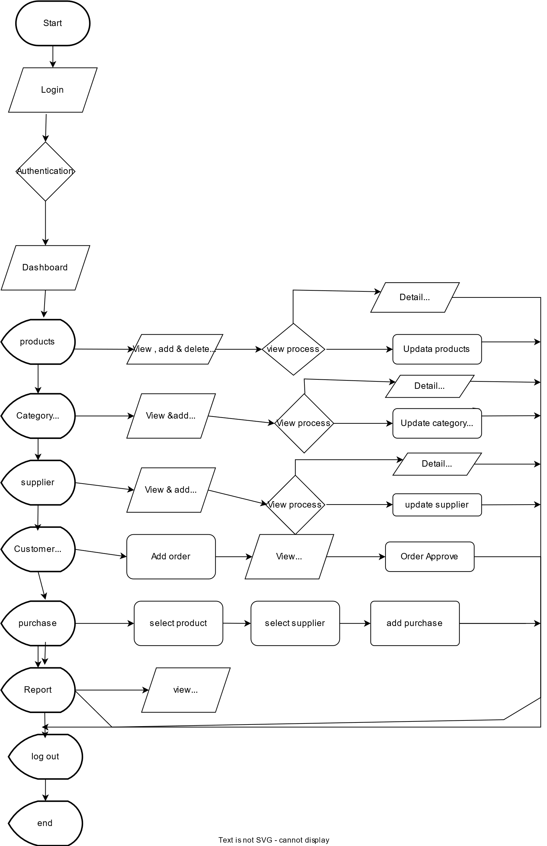
Data Model:

Slide 23
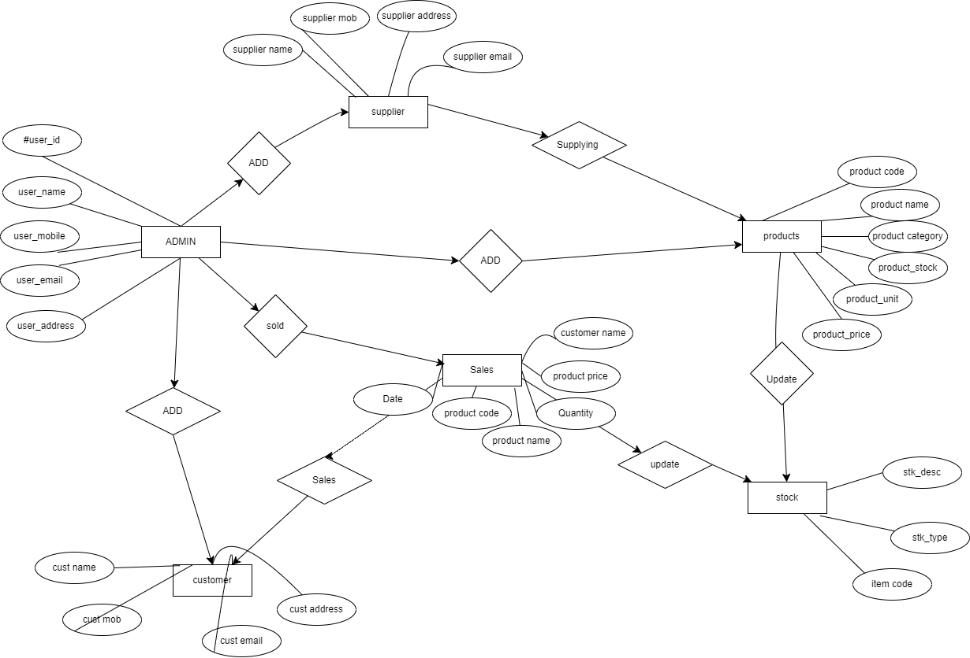
ER model

Slide 24
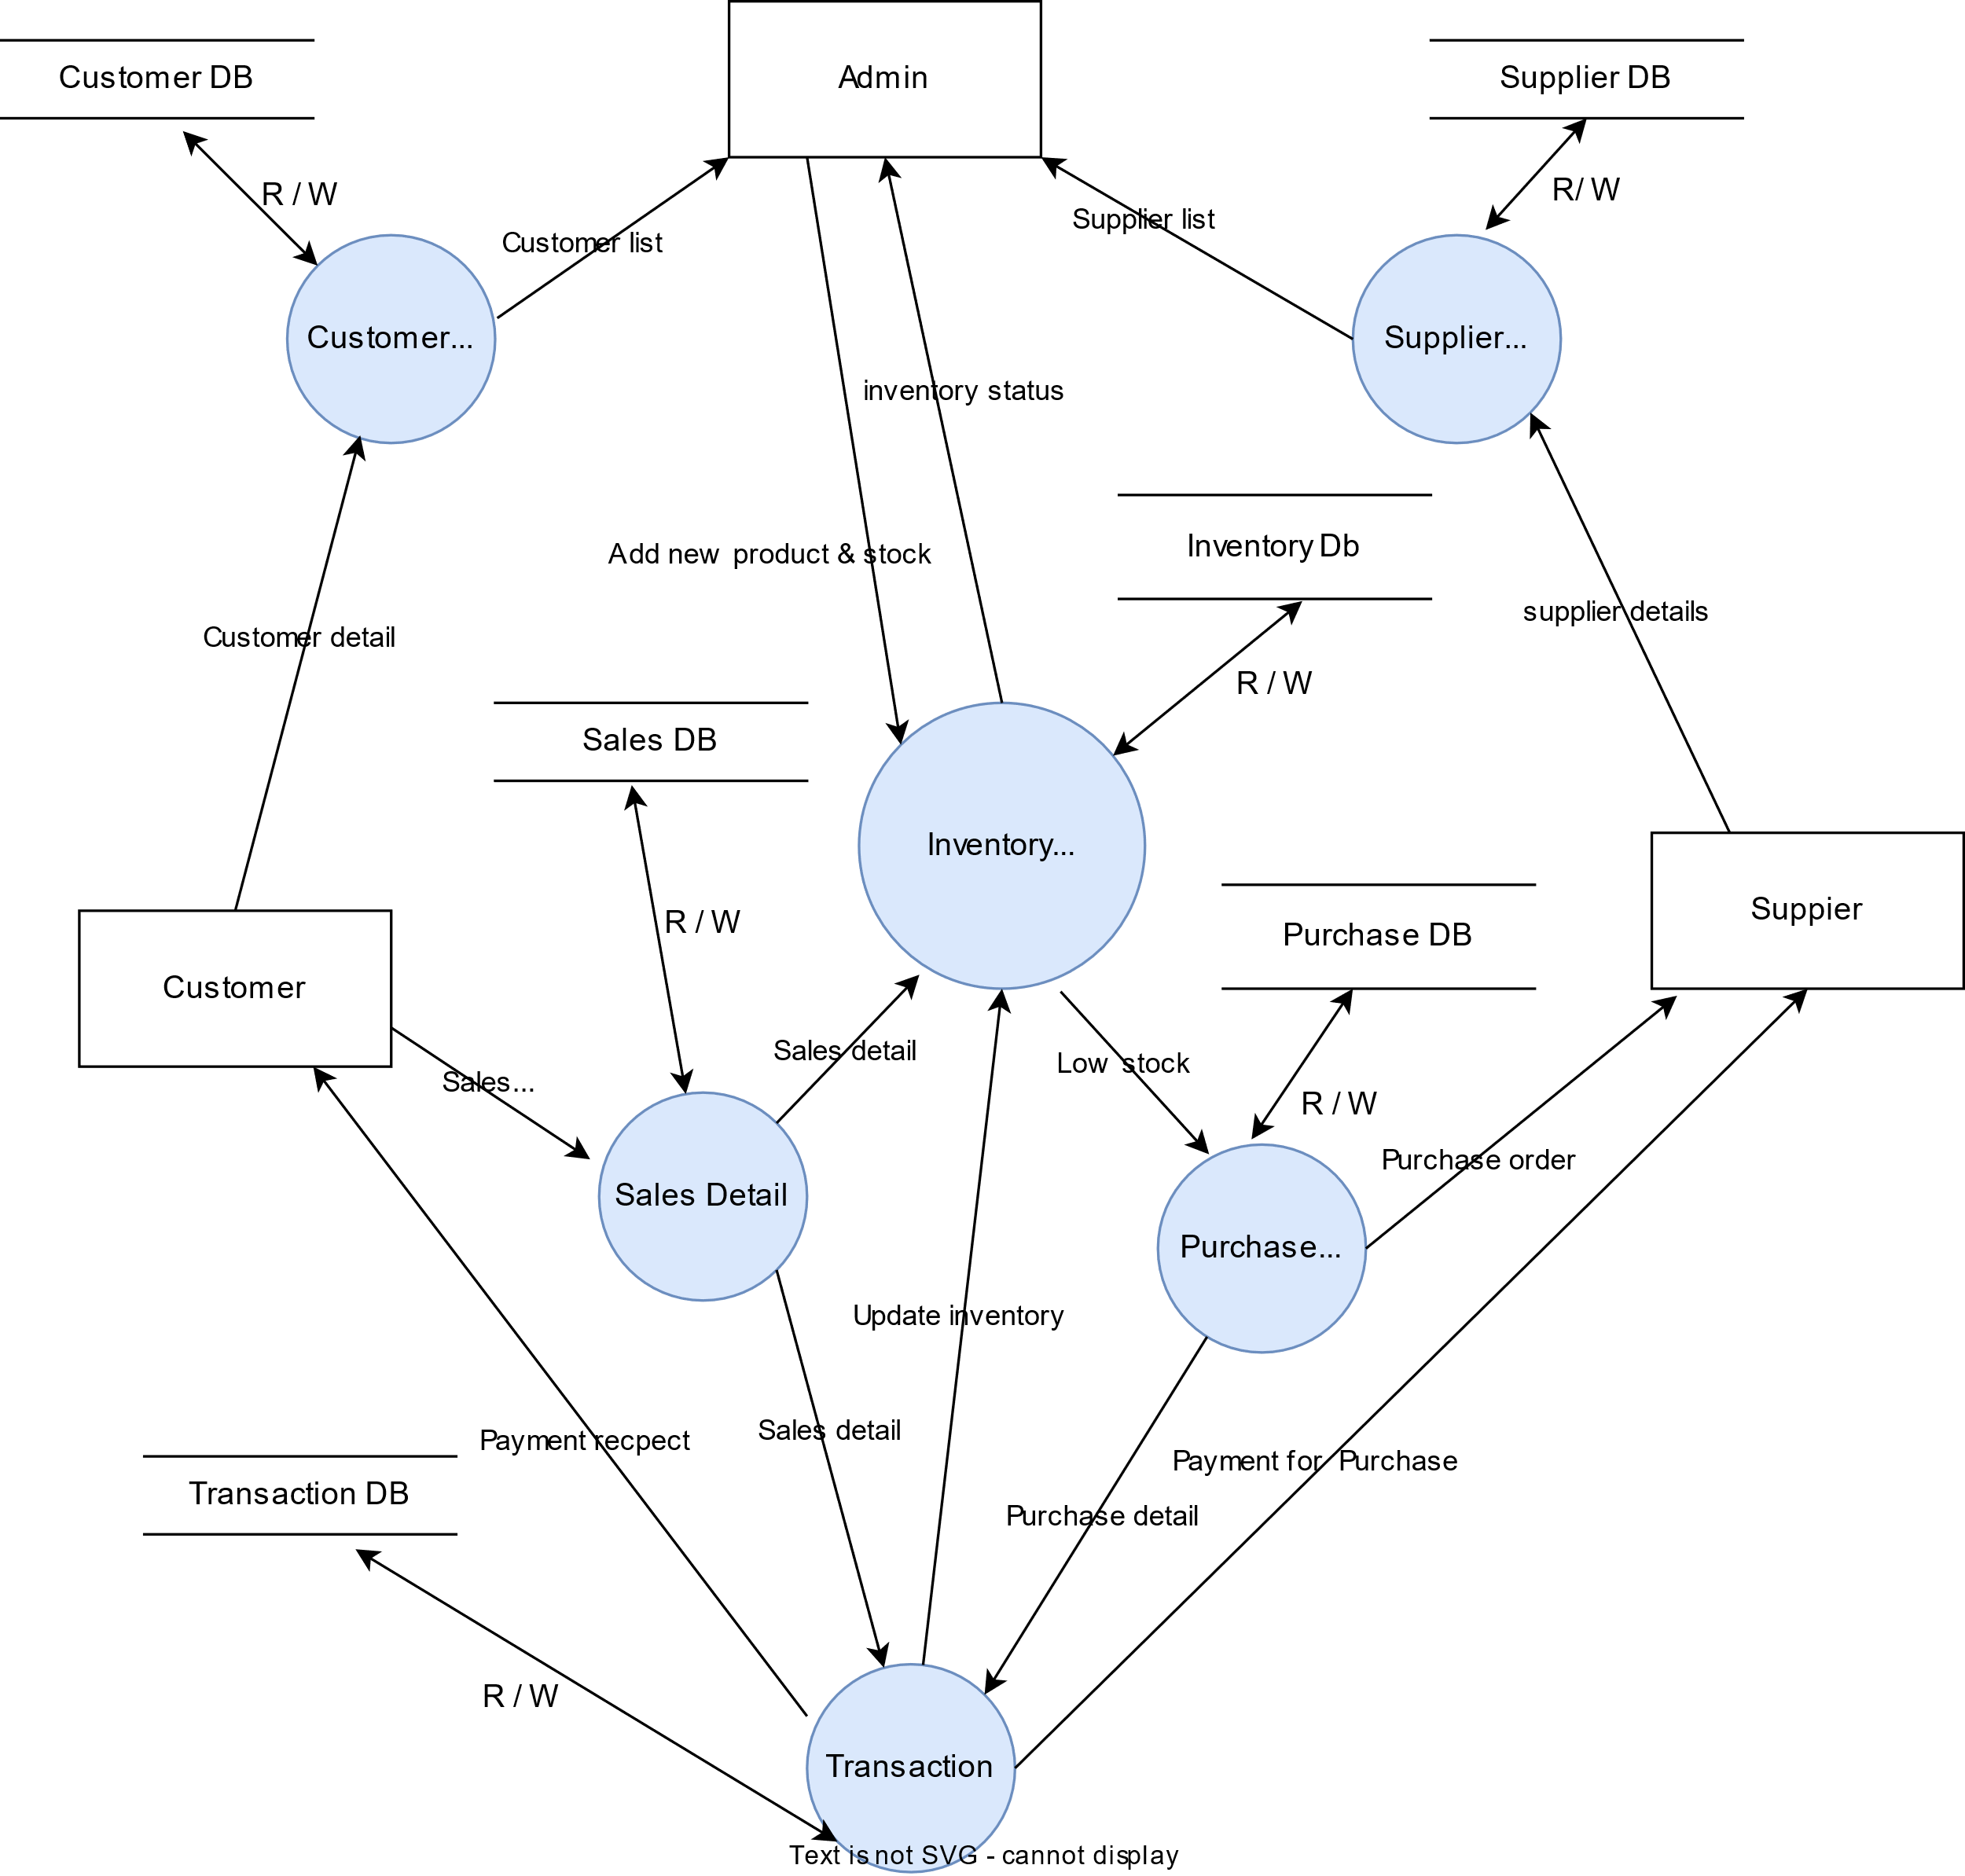
System architecture:

